Slide 1

Amazon Project

Slide 2
Project Details
Name- Puneet Jindal
Enrolment Number-EBEONO523757705
Project Name- Automation and Manual Project on Amazon (login,Search Product,Add to Cart and Buy Now) Using Selenium by Test-Ng.
Created Date-20-10-23
Submission Date-

Slide 3
Title
"Amazon Shopping Experience“
Subtitle
“Parallel test execution by using selenium with test-ng Login, Search, Add to Cart, Buy Now"

Slide 4
Introduction
Title:- Parallel test execution by using selenium with test-ng Login, Search, Add to Cart, Buy Now. 1.Welcome to our presentation on automating key Amazon shopping actions using Selenium and TestNG.
2. Parallel test execution is a software testing technique where multiple test cases or test suites are executed simultaneously on multiple computing resources. This approach is often used to improve the efficiency and speed of the testing process.
3.Automating tasks on Amazon can save time and improve efficiency, and this presentation will demonstrate how to do just that.
4.We will focus on four critical aspects of the Amazon shopping experience: Logging in, Searching for Products, Adding Items to the Cart, and Making a Purchase.

Slide 5
Objectives Faster Test Execution: The primary objective is to speed up the testing process by executing multiple test cases or test suites simultaneously. This helps in reducing the total test execution time, providing faster feedback to the development team. Efficient Resource Utilization: Parallel execution allows efficient use of computing resources, including CPU cores and machines, leading to cost savings and faster test completion.
Scalability: Parallel testing is scalable, which means it can handle an increasing number of test cases or test data without a linear increase in execution time.
Improved Test Coverage: By executing different test cases concurrently, parallel testing helps achieve better test coverage. It ensures that a wide range of scenarios and conditions are tested.
Improved Test Parallelization: Ensuring that test cases can run in parallel can lead to a more efficient and organized testing process, where dependencies are minimized.
Cost-Efficiency: Parallel test execution optimizes resource usage, which can lead to cost savings in terms of infrastructure and reduced testing time.
Early Bug Detection: Faster test execution allows for the early detection of bugs and issues, enabling quicker bug fixes and reducing the cost of addressing defects later in the development cycle.

Slide 6
Modules
1. Login: - How to login into an Amazon Account
2.Product Search: Demonstrating how to search for products effectively, utilize filters, and navigate categories to find desired items.
3. Adding Items to the Cart: Instructing users on how to add products to their shopping cart.
4. Buy Product: Show to buy the product and Walking through the steps involved in the checkout process

Slide 7
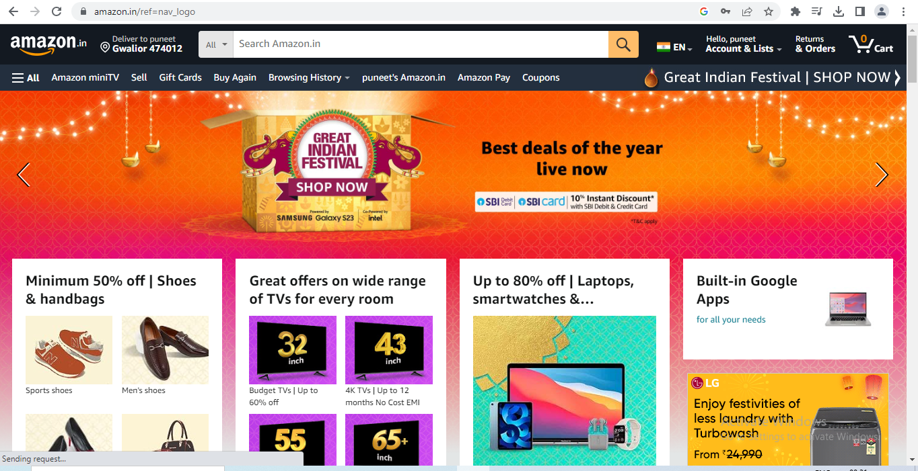
Navigating the Website
Navigate the website by clicking the url. https://www.amazon.in/

Slide 8
Login to Amazon
User can login with Email-id and Password
Enter a valid email-id
Enter a valid password
Click on sign-in
1.Initialize WebDriver:Inside the test method, initialize the WebDriver. This could be done by specifying which browser Chrome and providing the path to the browser driver executable geckoDriver
2.Navigate to Amazon:Use the get method to navigate to the Amazon website by providing its URL.
3.Locate Username and Password Fields: Use Selenium's findElement method to locate the username and password input fields on the Amazon login page. You can use locators like By.id
4Enter Username and Password: Use the sendKeys method to enter the username and password into their respective input fields.
5.Click the Login Button:Locate and click the login button, which will submit the login credentials for authentication.
6.Assertion: After clicking the login button, you can add assertions to verify whether the login was successful. You can check for elements or messages that confirm the successful login..
7.Close WebDriver: Finally, close the WebDriver instance to clean up resources.

Slide 9
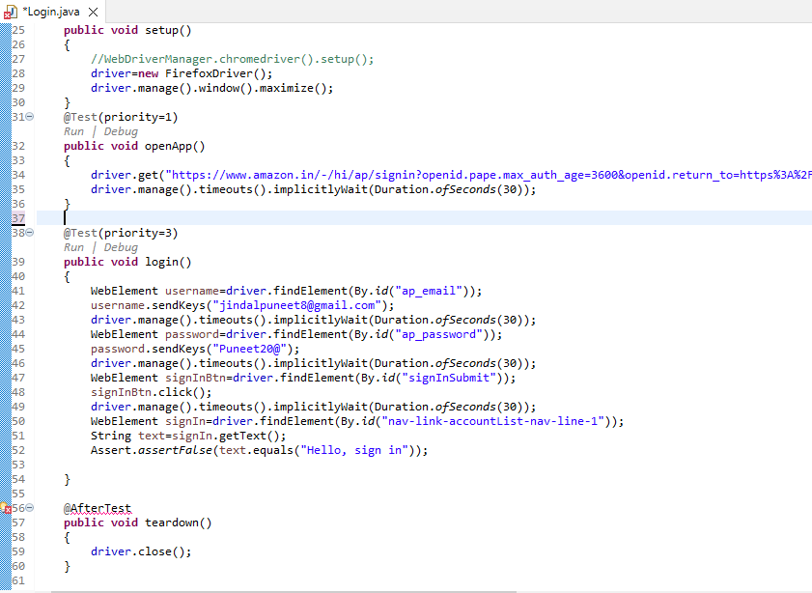
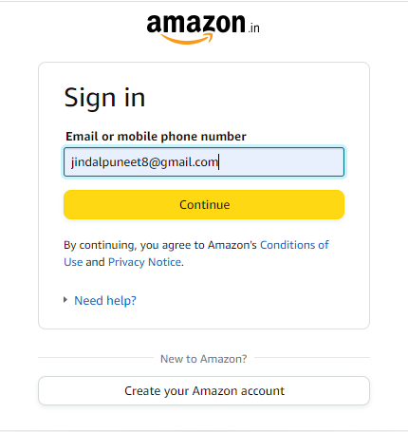
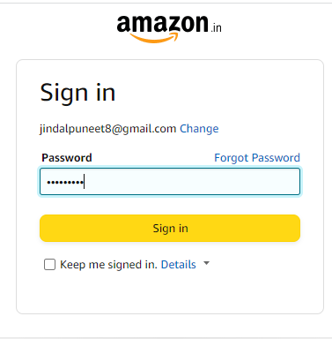

Slide 10
Searching for a Product
User can search the product on search bar
User can search for products using keywords, filters, and categories.
1.Initialize WebDriver:Inside the test method, initialize the WebDriver. This could be done by specifying which browser Chrome and providing the path to the browser driver executable ChromeDriver
2.Navigate to Amazon:Use the get method to navigate to the Amazon website by providing its URL.
3.Locate the Search Box:Use Selenium's findElement method to locate the search input field on the Amazon website. You can use various locators like By.id
4..Enter Search Query:Use the sendKeys method to enter the search query (Puma Sneakers for Men) into the search input field.
5..Submit the Search: Use the submit method on the search input field element to initiate the search. Alternatively, you can locate the search button and click on it.
6.Assertion: After submitting the search, you can assert that the search results page has loaded successfully. You can check for specific elements on the search results page to ensure that the search was successful.
7.Close WebDriver: Finally, close the WebDriver instance to clean up resources.

Slide 11
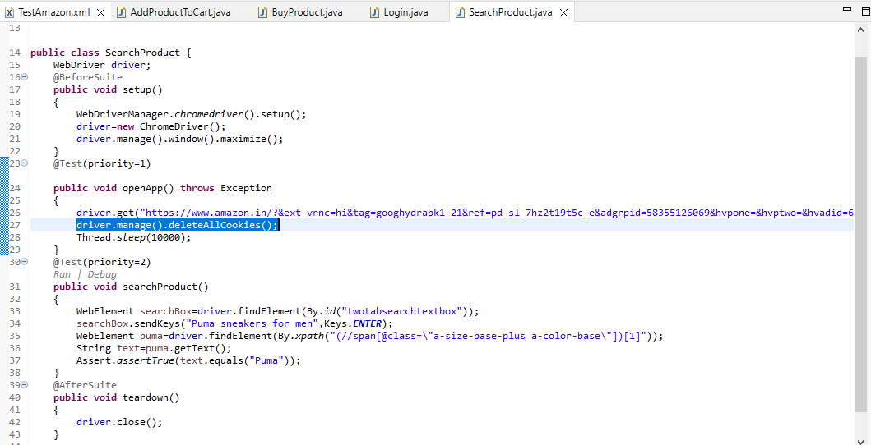
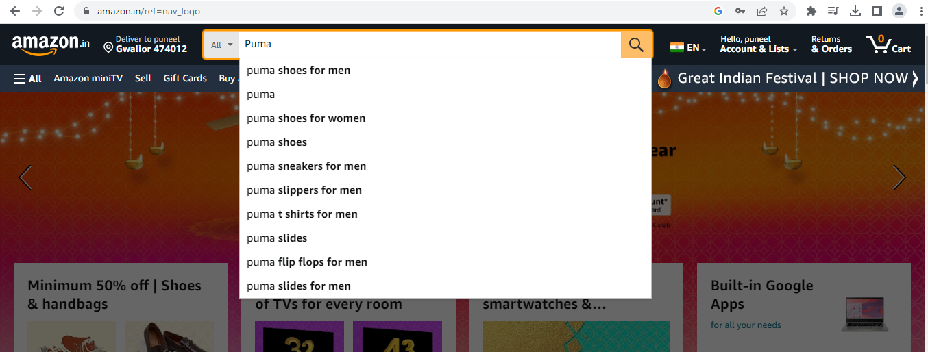
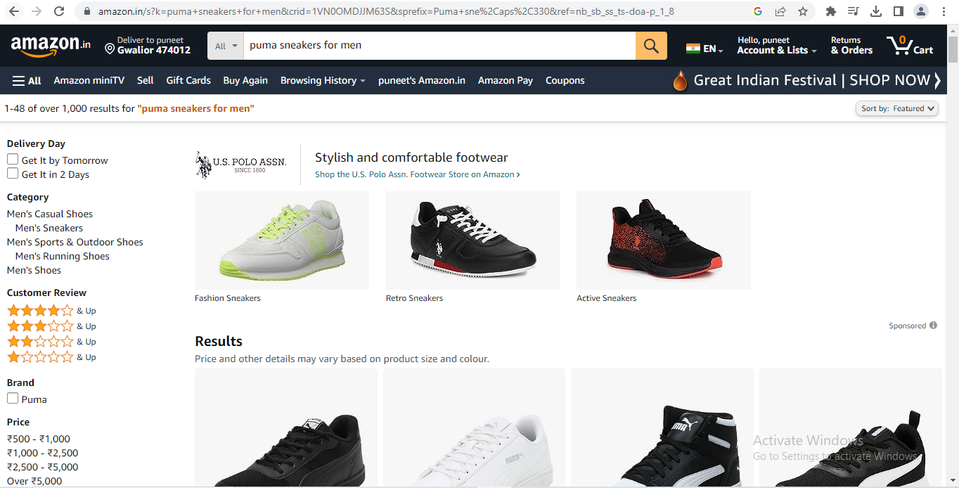

Slide 12
Add to Cart
User Can add the product into the cart.
Select the product with quantity.
Click on add to cart.
Product will be added into the cart Successfully.
1.Initialize WebDriver: Inside the test method, initialize the Web Driver. This could be done by specifying which browser Chrome and providing the path to the browser driver executable Chrome Driver
2.Navigate to Amazon: Use the get method to navigate to the Amazon website by providing its URL.
3.Locate the Search Box:Use Selenium's find Element method to locate the search input field on the Amazon website. You can use various locators like By.id. Use the send Keys method to enter the search query (Puma Sneakers for Men) into the search input field.
4.Select a Product : On the search results page, locate and click on a product that you want to add to the cart. Use findElement and click methods for this.
5.Add to Cart: Once you're on the product page, locate the "Add to Cart" or "Buy Now" button. Use findElement to locate it and then use the click method to add the item to the cart.
6.Assertion: After adding the item to the cart, you can add assertions to verify that the item has been successfully added to the cart. You may check for elements or messages that confirm the addition.
7.Close Web Driver: Finally, close the Web Driver instance to clean up resources.

Slide 13
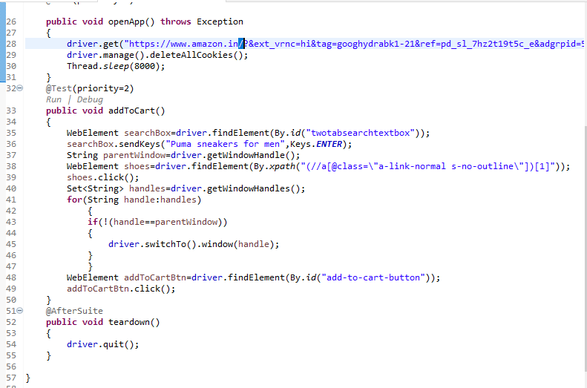
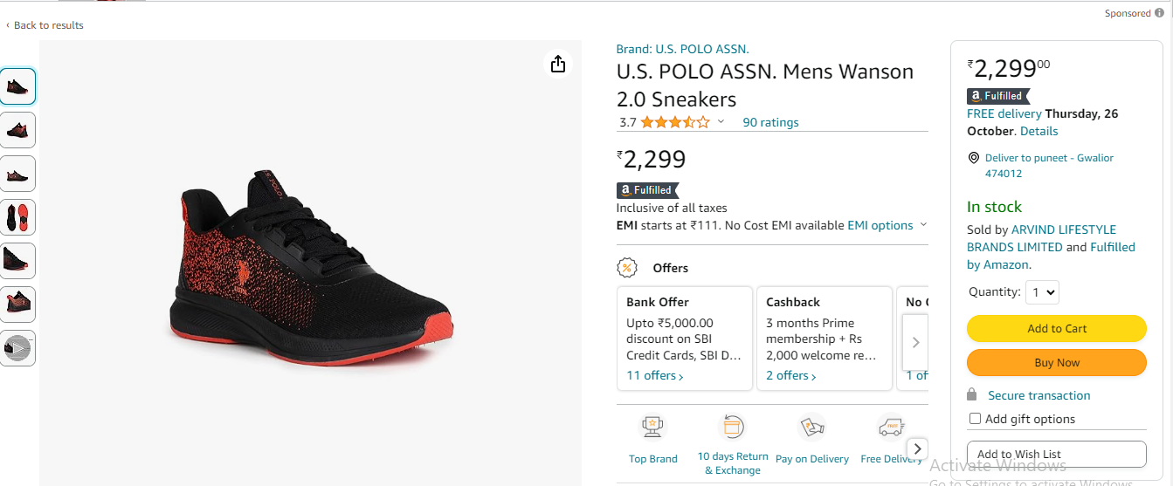
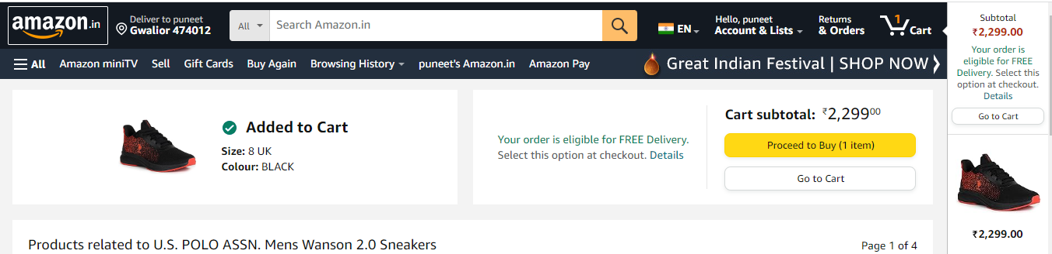

Slide 14
Buy Now
User Can Buy the product.
Click on proceed to buy product.
Add the delivery address.
Choose the payment Option.
1.Initialize WebDriver: Inside your test method, initialize the WebDriver. Specify the browser you intend to use (e.g., Chrome, Firefox) and provide the path to the browser driver executable ChromeDriverNavigate to Amazon: Use the get method to navigate to the Amazon website.
2.Search for a Product: Locate the search input field using Selenium's findElement method, specifying a locator such as By.id, By.name, or By.xpath.Enter your search query into the input field using the sendKeys method.Submit the search by either pressing Enter or clicking a search button.
3.Select a Product: On the search results page or the product page, locate and click on the product that you want to purchase. Use the findElement and click methods for this.Click "Buy Now": Once you're on the product page, locate and click the "Buy Now" button. Use the findElement and click methods to perform this action.
4..Place the Order: Locate the "Place your order" or "Buy Now" button (the final confirmation step) and use the click method to place the order.
5.Assertion (Optional): After placing the order, you can add assertions to verify that the purchase was successful. You may check for elements or messages that confirm the order.
6.Close WebDriver: Finally, close the WebDriver instance to release system resources and terminate the test.

Slide 15
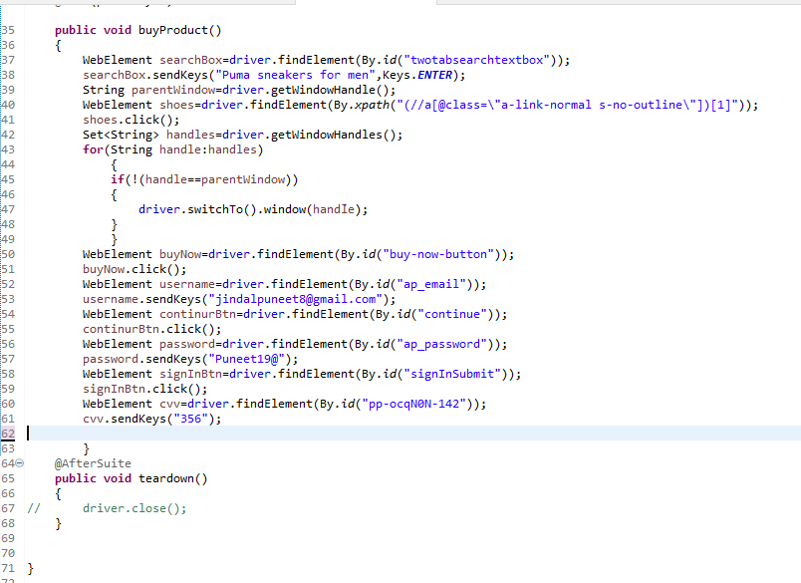
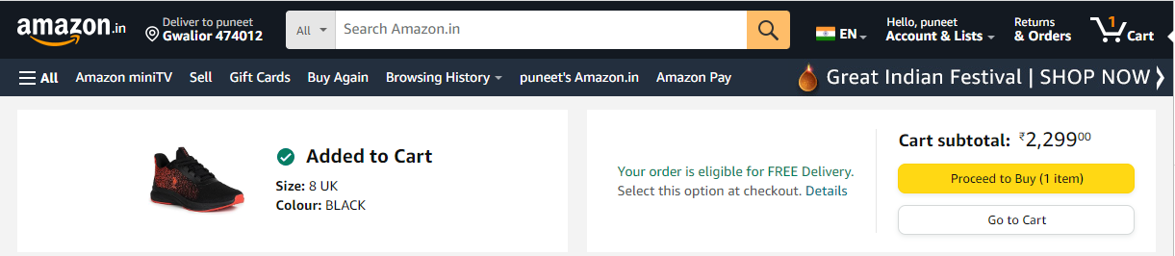
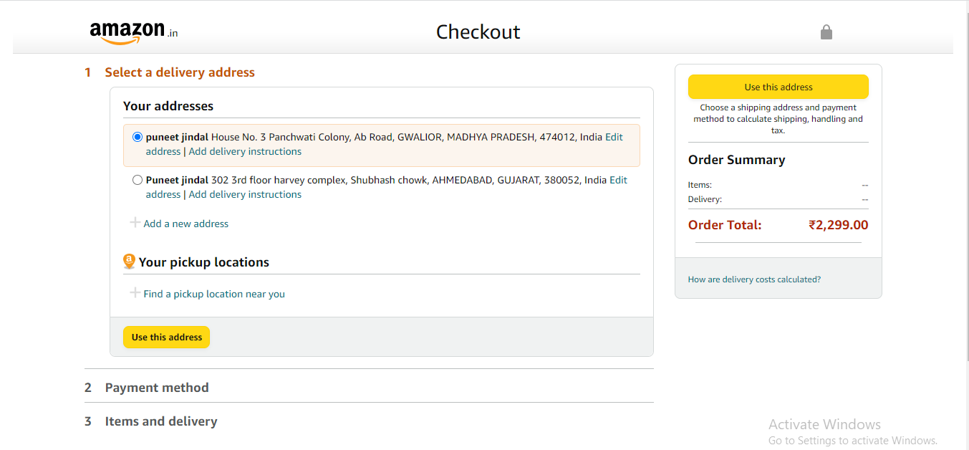

Slide 16
PRESENTATION TAKEAWAYS
Automation Streamlines Online Shopping: Automation can significantly enhance the online shopping experience on Amazon by making tasks like login, product searching, adding to cart, and purchasing more efficient and accurate.
Selenium is a Powerful Tool: Selenium is a robust and widely-used automation testing framework that can be employed to automate web interactions, making it an ideal choice for automating Amazon.
Benefits of Automation: Automation offers numerous advantages, including improved accuracy, faster execution, and the reduction of manual effort, ultimately enhancing the user experience on Amazon.
Test Environment Setup: A proper test environment setup is essential for Selenium automation, including installing necessary drivers and dependencies..
Enhancing Efficiency: Automation not only reduces manual work but also enhances the overall efficiency of the shopping process, saving time and effort.
Future Possibilities: The skills learned in this presentation can be extended to automate other aspects of Amazon shopping or applied to automate interactions on other websites.

Slide 17


